Slide 1

EmberJS
or How I learned to stop worrying and love JavaScript frameworks

Slide 2


About me - José David Cano
Bachelor’s in Computer Science (UM)
6+ years of experience on Full-Stack web development, working on the backend using PHP.
Currently working as a Senior Frontend Developer and Technical Lead on Neuromobile.
I’m also a DJ who loves videogames. Up for some Overwatch or HearthStone hit me up at Gorzas#2117.
@gorzas

Slide 3
JavaScript framework mayhem

Slide 4
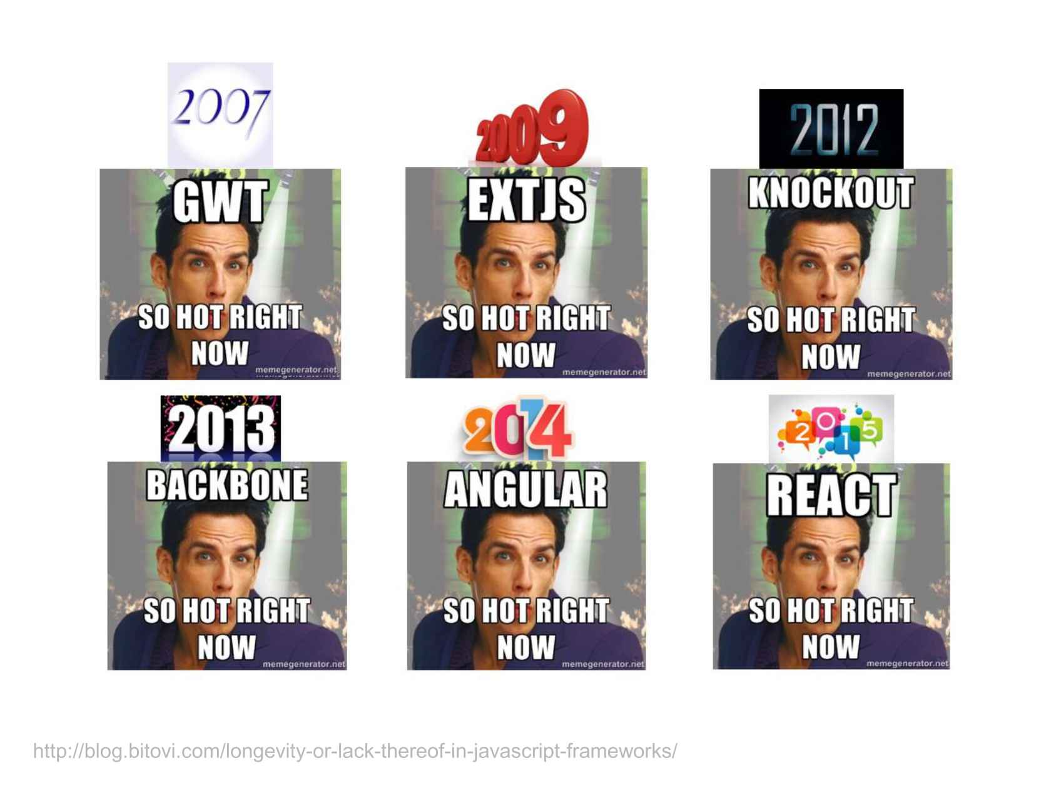
Notes:
2016. Vue
2017. Inferno?

Slide 5
The JavaScript framework mayhem
Lots of frameworks, everyone borns to solve a different problem
Short life expectancy
Choose one is like “marry” one: it’s hard to change to another framework after it has been implemented on your WebApp
JavaScript fatigue
HDD (Hype-Driven Development)
Notes:
HDD - https://blog.daftcode.pl/hype-driven-development-3469fc2e9b22#.12ib8zwne

Slide 6
Why Ember?
Framework MVC & SPA
Convention over configuration
Testing environment
Great community and life expectancy (LinkedIn, Twitch, Discourse, Apple Music…)
Based on future standards (WebComponents, JSON API…)
Six-week release cycle with backwards compatibility
Legacy browser support (IE9)

Slide 7
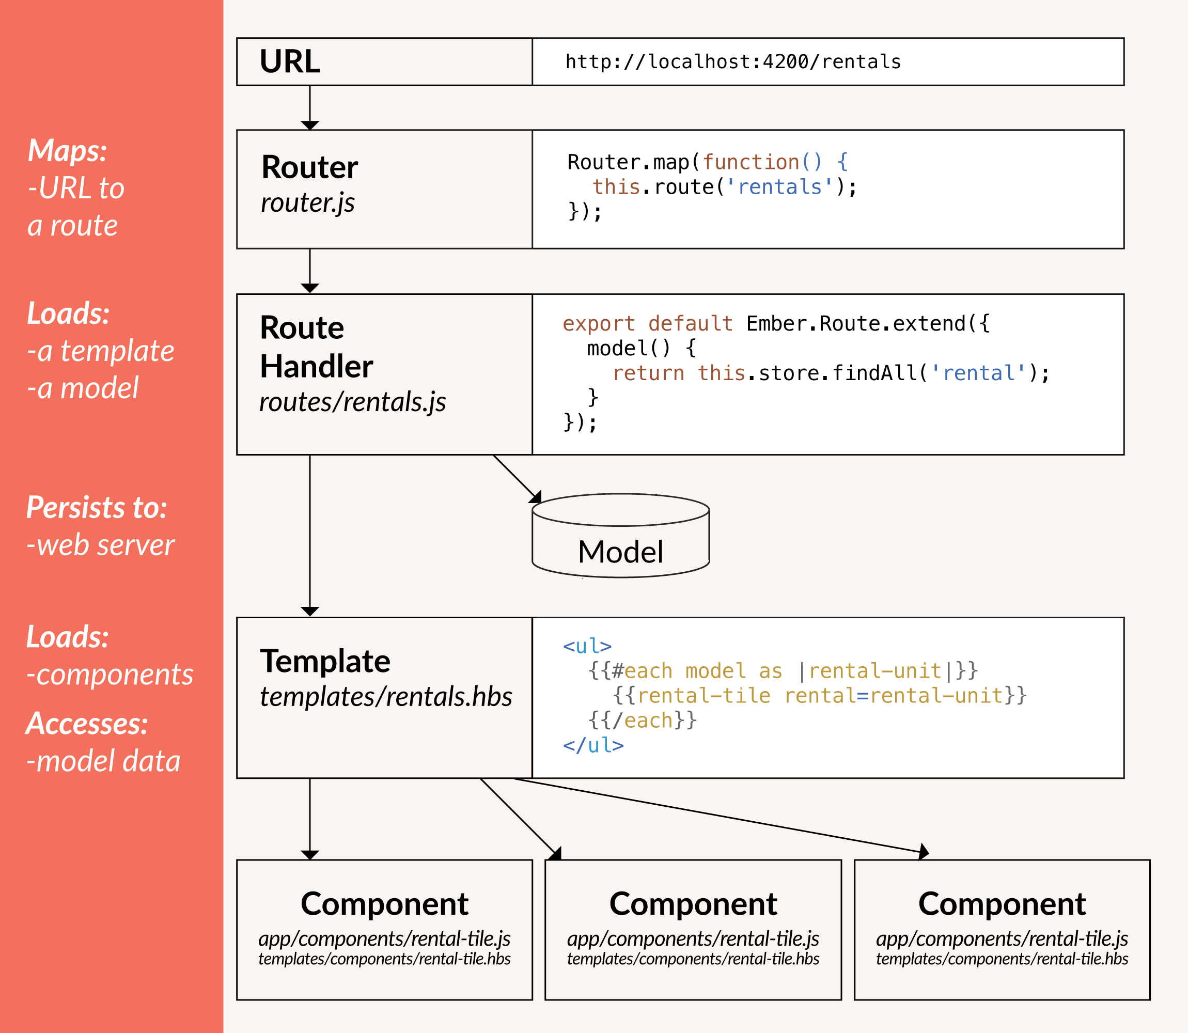
Core concepts
Router & Routes
Models
Templates
Components

Slide 8
Let’s get started!

Slide 9
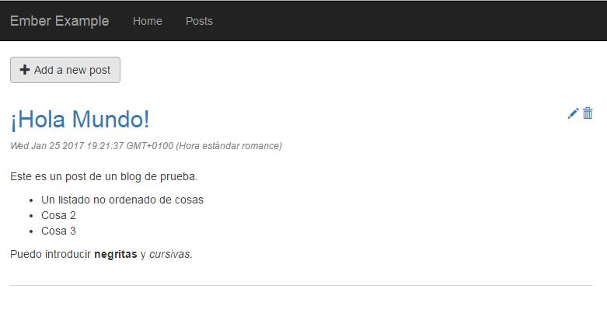
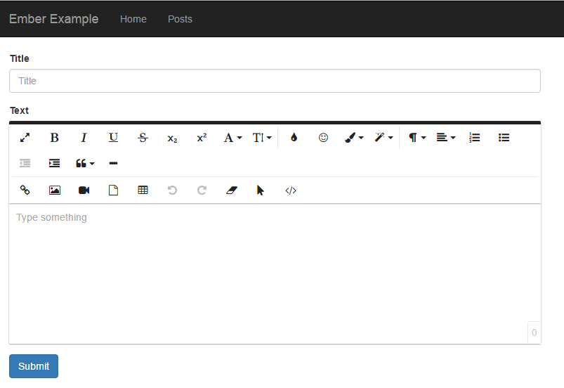
An example
A basic CMS made with ember

Slide 10
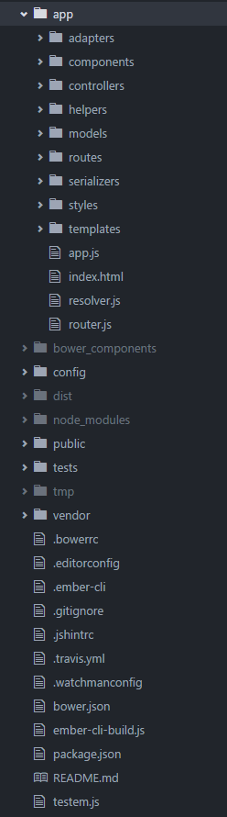
First steps
Install ember-cli
npm install -g ember-cli
Create new application
ember new ember-example
Launch the app
ember server --watcher
ember test (--server)

Slide 11
Templating
Uses Handlebars templating library, mixing HTML static with dynamic content
Basics:
Render a property: {{value}}
Conditionals:
{{if value “show”}}
{{#if value}}<strong>{{value}}</strong>{{/if}}
{{unless value “hide”}}
Loops:
{{#each posts as |post|}}<li>{{post}}</li>{{/each}}

Slide 12
Templating - application.hbs
ember g template application
Main template of the app, it’s always on the screen.
Route template will be rendered in an {{outlet}} helper.

Slide 13
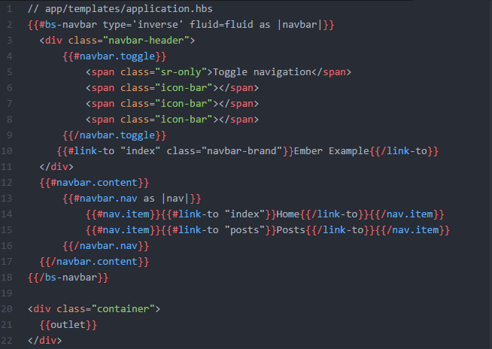
Templating - application.hbs

Slide 14
Routes
Creating a new route:
ember g route posts
Loads data to be available on the template
Creates:
app/routes/posts.js
app/templates/posts.hbs
tests/unit/routes/posts.js

Slide 15
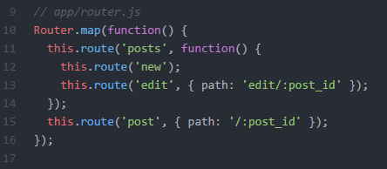
Routes

Slide 16
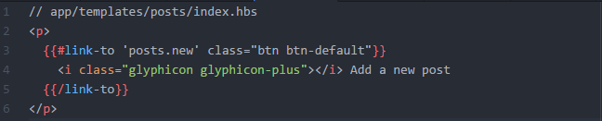
link-to helper
Redirects to route /posts/new
Allows parameters: {{#link-to ‘posts’ post}}

Slide 17
Models
ember g model post
Added with Ember-Data library (included in ember-cli)
Represents underlying data of the app
Transforms: translates server data to UI data and viceversa (default types: boolean, date, string and number)
Methods belongsTo and hasMany to define relationships between models
By default, it uses JSON API

Slide 18
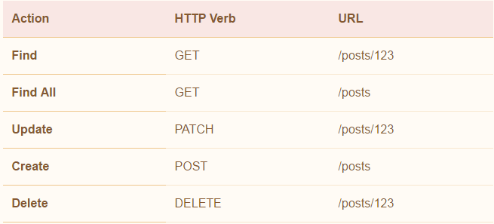
Models

Slide 19
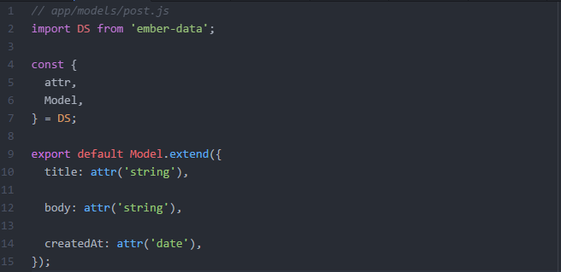
Models

Slide 20
Components
ember g component form-blog-post
Must have at least one dash in the name
Creates:
app/component/form-blog-post.js
app/templates/components/form-blog-post.hbs
tests/integration/components/form-blog-post-test.js
Data down, actions up

Slide 21
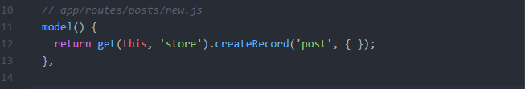
Routes - model
Gets data from the storage (usually the server) and makes it available in the template

Slide 22
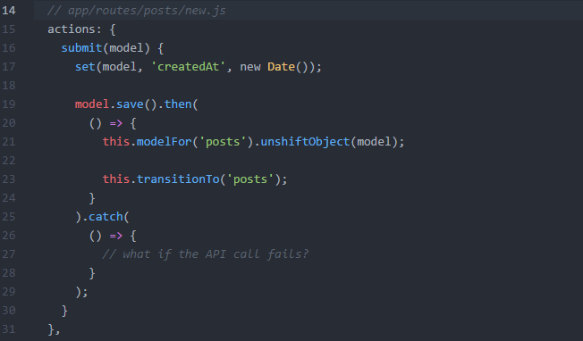
Route/controller - actions
Callback for events on templates and inner components
Can define them in routes and controllers
For enable actions on routes you’ll need the library ember-route-action-helper

Slide 23

Route - posts/new.hbs

Slide 24
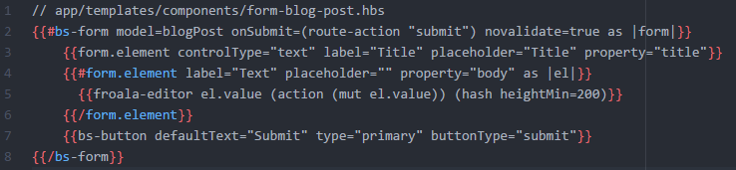
Components - form-blog-post.hbs

Slide 25
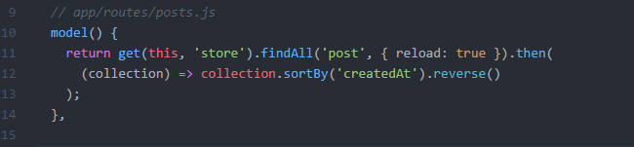
Showing a list of posts

Slide 26
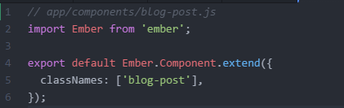
Components - blog-post
Good practice: add className with the component name to encapsulate styles

Slide 27
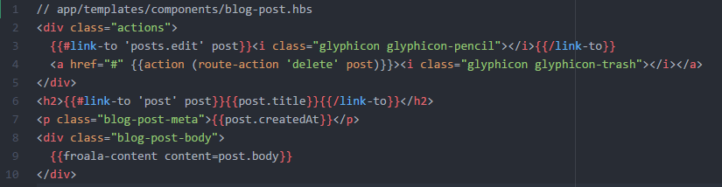
Components - blog-post

Slide 28
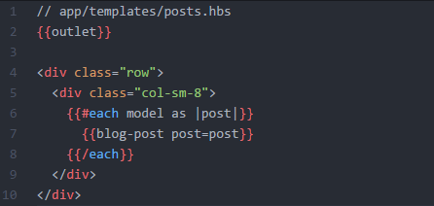
Showing a list of posts
{{outlet}} helper shows nested routes (posts.index, posts.new and posts.edit).

Slide 29
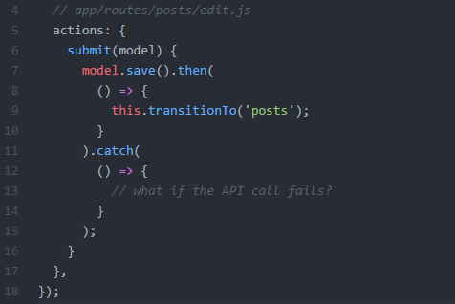
Update a post
Route posts/edit/:post_id
Loads the model automatically.
Reuses component form-blog-post

Slide 30
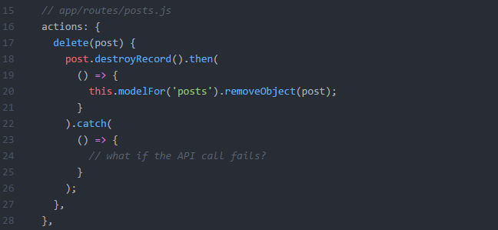
Delete a post

Slide 31
Other elements
Services
Custom handlebars helpers
Transforms
Adapters and serializers
Ember inspector

Slide 32
Resources
Ember-Cli - https://ember-cli.com/
Guide - https://guides.emberjs.com/v2.11.0/
Slack - https://ember-community-slackin.herokuapp.com/
Styleguide - https://github.com/netguru/ember-styleguide
Example code - https://github.com/Gorzas/ember-example

Slide 33
Thanks!

